Slide 1
Machine Translation
W266: Natural Language Processing

Slide 2
Announcements
Project Proposal - due 10/14 11:59 pm Pacific
Be sure to read the instructions!
Assignment 3 (Language Models) released later this week

Slide 3
Midpoint Feedback
Super low feedback rate, not much data... easy to overfit?
If you didn’t complete the feedback, feel free to send us (anonymous) feedback on Piazza!

Slide 4
Midpoint Feedback
Super low feedback rate, not much data... easy to overfit?
Feedback: Wasn’t much really submitted yet, so really noisy, but remember...
A1 feedback was released last Saturday, if you don’t see it, please let us know with a private Piazza post
TA hold a (recorded) tutorial during their office hour after an assignment is due covering the solutions.
Release date is hard for those in the +XX hour time zones (as it turns into Saturday morning). We’ll try to release earlier!

Slide 5
Midpoint Feedback
Super low feedback rate, not much data... easy to overfit?
More Papers!
Seemed as though many students wished we pointed you to more state of the art research.
We are going to hold additional paper reading sessions!
If you have specific topics in mind: https://piazza.com/class/jknbtsr3vfw2uy?cid=192

Slide 6
The plan...
This week:
MT Evaluation
Classical MT
Noisy-Channel model
Word- and phrase-based MT
Introductory Neural MT
Next week:
Deep dive into Neural MT

Slide 7
MT is *really* hard
Why?

Slide 8
MT is *really* hard
Division of words (i.e. Eskimo)
Syntax differences
SVO (like English) vs. SOV (like Japanese)
Placement of adjectives
Head marking
The man's house vs. "the man house-his" (in Hungarian)
Referential density
Lack of vs presence of pronouns
Homonyms
bass (the fish? the instrument?)

Slide 9
MT is *really* hard
Polysemy
I know vs. Je connais or Je sais (in French)
Gender
La pomme
Lack of similar context
Brother vs "older/younger brother" (in Chinese/Japanese)
Translation is not a one-to-one mapping!
Notes:
Connais: “I know… about…”
Sais: “I know <fact>”.

Slide 10
Which one seems best?
Japanese: "fukaku hansei shite orimasu"
English:
"I'm sorry"
"We are deeply reflecting (on our past behavior, and what we did wrong, and how to avoid the problem next time)"
Hebrew: "adonai roi" (the Lord is my shepherd)
Suppose a culture has no sheep...
"the Lord will look after me"
"the Lord is for me like somebody who looks after animals with cotton-like hair"
Faithfulness vs. Fluency

Slide 11
Back in the old days...

Slide 12
Classical MT
Direct translation model (lookups, phrase tables)
Some local reordering included
i.e. I am eating the apple. -> Je mange la pomme.
Transfer model (syntactic MT)
Transform the parse tree
i.e. English to Spanish; NP -> JJ NN becomes NP -> NN JJ
i.e. The green witch -> La bruja verde
Interlingua model (holy grail?)
Extract meaning
Event-based representation

Slide 13
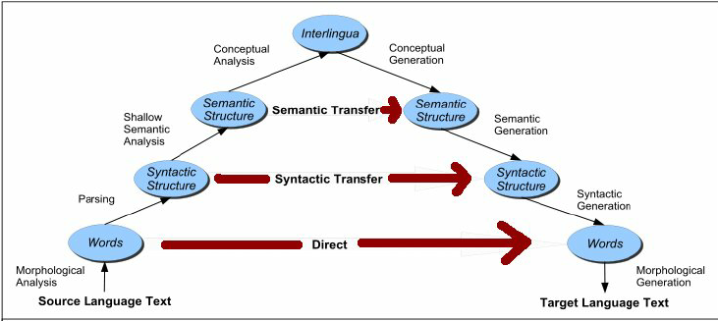
Vauquois Triangle
(Vauquois, 1968)

Slide 14
Evaluation Metrics: BLEU

Slide 15
Evaluating Machine Translation
Ideal: human judgments
Adequacy: does this capture the information?
Fluency: is this a good sentence?
Gold standard: pay humans to rate output

Slide 16
BLEU motivation
Why is an automated eval important for machine translation?
What makes automated evaluation hard?
What makes us think that evaluation is possible?
Notes:
Desiderate: low cost, tunable, meaningful, consistent, correct (correlates with humans)

Slide 17
BLEU motivation
Why is an automated eval important for machine translation?
Problem: humans are expensive, slow, & inconsistent
What makes automated evaluation hard?
What makes us think that evaluation is possible?

Slide 18
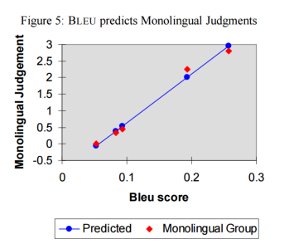
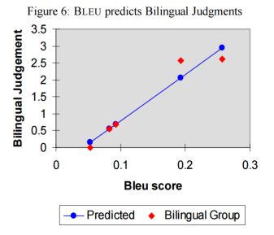
Evaluation seems possible!
BLEU: http://aclweb.org/anthology/P/P02/P02-1040.pdf (IBM, 2002)

Slide 19
BLEU formulation
Idea #1: Precision
How many of the words in the candidate translation occur in a reference?

Slide 20
BLEU formulation
Idea #1: Precision
How many of the words in the candidate translation occur in a reference?
Problem:
Candidate: the the the
Reference: the cow jumped over the moon
Precision?

Slide 21
BLEU formulation
Idea #2: Max credit
How many of the words in the candidate translation occur in a reference?
(Cap numerator of precision by # of times word seen in reference.)
Better:
Candidate: the the the the the the
Reference: the cow jumped over the moon
Precision?

Slide 22
BLEU formulation
Idea #3: Unigrams are too small of a unit
How many of the words in the candidate translation occur in a reference?
(Cap numerator of precision by # of times word seen in reference.)
(<= 4-grams)
Smaller n-grams stop correlating with monolingual judgements on fluency.
N-gram overlap helps enforce loosely-consistent word ordering.

Slide 23
BLEU formulation
Idea #4: Brevity Penalty
How many of the words in the candidate translation occur in a reference?
(Cap numerator of precision by # of times word seen in reference.)
(<= 4-grams)
(Trivial translations are likely bad)
Penalty = e^(min(0, 1 - ref_len / mt_len))

Slide 24
BLEU formulation
Extensions:
Corpus level
Multiple reference sentences
How long to optimize for?
Compare references against one another is a good measure of benchmark usefulness

Slide 25
Evaluation seems possible!
BLEU: http://aclweb.org/anthology/P/P02/P02-1040.pdf (IBM, 2002)

Slide 26
Automatic Evaluation TL;DR
BLEU: N-gram precision (n = 1,2,3,4) plus brevity penalty
Correlates well between related systems
Weaker correlation across different systems (rules, PBMT, neural)
Possible to over-optimize, lose correlation with human judgment
Lots of known shortcomings: word importance, re-ordering
Ideally, tune on BLEU then run human evals at end
See recent works from Google, MS, WMT workshops, etc.

Slide 27
Statistical MT
End goal: evaluate P(hello | bonjour)
A taste of “understandable models don’t work very well… and end up being so complicated, they aren’t even understandable”.

Slide 28
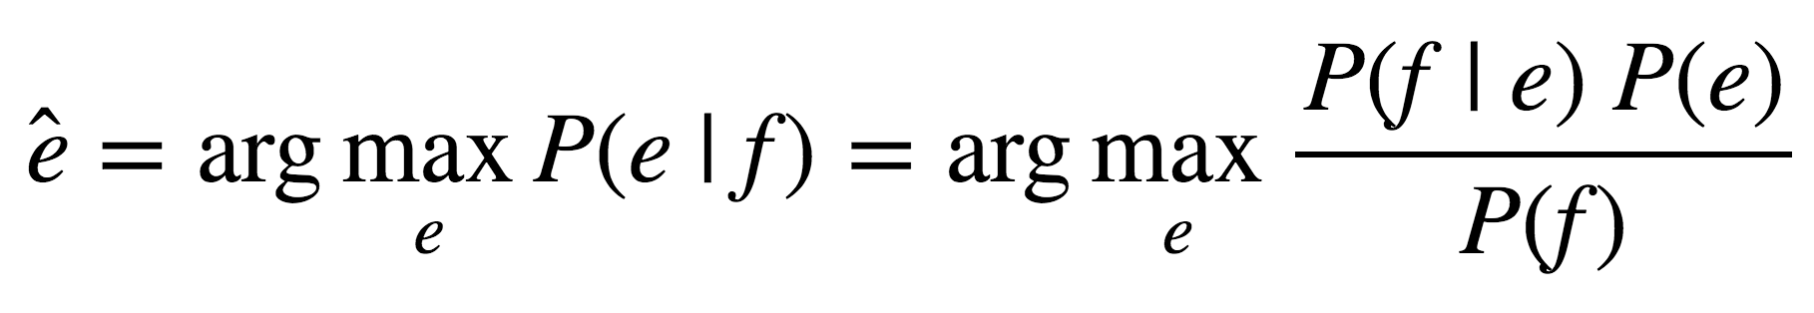
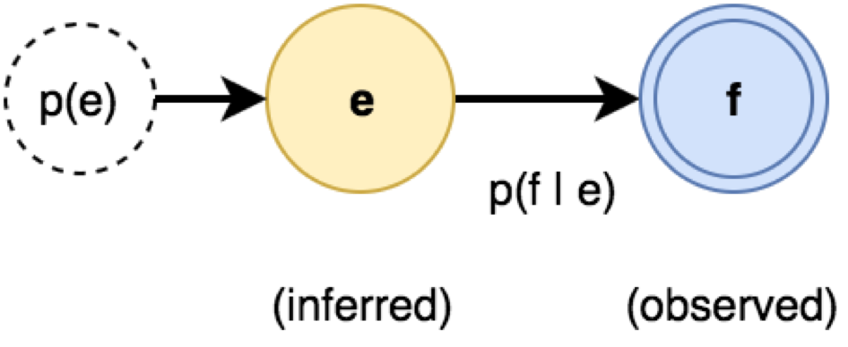
The Noisy Channel Model
For Machine Translation, translate f → e
P(e) : source (language model)
P(f|e) : channel (translation model)
“...one naturally wonders if the problem of translation could conceivably be treated as a problem in cryptography. When I look at an article in Russian, I say: ‘This is really written in English, but it has been coded in some strange symbols. I will now proceed to decode.’ ”
Warren Weaver, 1947
Notes:
3 parts to the model: P(e): the language model, P(f|e): the translation model, P(e|f): decoder

Slide 29
IBM Alignment Models
The critical hypothesis: all content is in the target language. A noisy channel “corrupts” some material into the source language.
If we can model the statistical properties of the corruption, we can find the most likely source material that ended up corrupted in the way we’ve found the material.
P(e)
p(a | e)
P(a | e)
t(f | e)
P(f | a, e)
Generation
(never used)

Slide 30
IBM Alignment Models
The critical hypothesis: all content is in the target language. A noisy channel “corrupts” some material into the source language.
One (dubious) claim about how this noisy channel works:
Alignment: Randomly reorder the tokens
Token translation: Randomly substitute tokens from the source language for tokens of the target language
P(e)
p(a | e)
P(a | e)
t(f | e)
P(f | a, e)
Generation
(never used)

Slide 31
IBM Alignment Models
Generative process e → f with P(f | e)
Latent variable model for P(f | e)
P(f | e) = P(f | a, e) P(a | e)
Hidden variable: alignment a_{i}
Parameters: t(f | e_{ai})
Use Bayes’ rule to compute P(e | f)
Decode using beam search over P(f | e) P(e)
P(e)
p(a | e)
P(a | e)
t(f | e)
P(f | a, e)
Generation
(never used)

Slide 32
IBM Alignment Models: Inference
Generative process e → f with P(f | e)
Latent variable model for P(f | e)
P(f | e) = P(f | a, e) P(a | e)
Hidden variable: alignment a_{i}
Parameters: t(f | e_{ai})
Use Bayes’ rule to compute P(e | f)
Decode using beam search over P(f | e) P(e)
P(e)
P(e | f)
p(a | e)
P(a | e)
P(a | f, e)
t(f | e)
P(f | a, e)
f
Generation
(never used)
Inference

Slide 33
What is P(f | e) ?

Slide 34
IBM Model 1
Noisy-channel translation f → e
Model: generative process e → f with P(f | e)
Sample a length m ∼ Q(m)
Distribution Q(m) doesn’t matter!
Sample an alignment {a_{i}} for i = 1,...,m
Sample a word f_{i} from t(f | e_{ai})
the
blue
house
NULL
m = 3

Slide 35
IBM Model 1
Noisy-channel translation f → e
Model: generative process e → f with P(f | e)
Sample a length m ∼ Q(m)
Distribution Q(m) doesn’t matter!
Sample an alignment {a_{i}} for i = 1,...,m
a_{i} ∼ Uniform(0, ℓ + 1)
a_{i} independent
Sample a word f_{i} from t(f | e_{ai})
the
blue
house
NULL
a₁ = 1
m = 3
Notes:
Note the NULL word we add to the source. This allows us to generate (crudely) spurious words in the target. We can always handle spurious source words by simply not aligning to them.

Slide 36
IBM Model 1
Noisy-channel translation f → e
Model: generative process e → f with P(f | e)
Sample a length m ∼ Q(m)
Distribution Q(m) doesn’t matter!
Sample an alignment {a_{i}} for i = 1,...,m
a_{i} ∼ Uniform(0, ℓ + 1)
a_{i} independent
Sample a word f_{i} from t(f | e_{ai})
the
blue
house
NULL
a₁ = 1
a₂ = 3
m = 3

Slide 37
IBM Model 1
Noisy-channel translation f → e
Model: generative process e → f with P(f | e)
Sample a length m ∼ Q(m)
Distribution Q(m) doesn’t matter!
Sample an alignment {a_{i}} for i = 1,...,m
a_{i} ∼ Uniform(0, ℓ + 1)
a_{i} independent
Sample a word f_{i} from t(f | e_{ai})
the
blue
house
NULL
a₁ = 1
a₂ = 3
a₃ = 2
m = 3

Slide 38
IBM Model 1
Noisy-channel translation f → e
Model: generative process e → f with P(f | e)
Sample a length m ∼ Q(m)
Distribution Q(m) doesn’t matter!
Sample an alignment {a_{i}} for i = 1,...,m
a_{i} ∼ Uniform(0, ℓ + 1)
a_{i} independent
Sample a word f_{i} from t(f | e_{ai})
t(f | e) tabulated
the
blue
house
NULL
la
m = 3
t(la | the)

Slide 39
IBM Model 1
Noisy-channel translation f → e
Model: generative process e → f with P(f | e)
Sample a length m ∼ Q(m)
Distribution Q(m) doesn’t matter!
Sample an alignment {a_{i}} for i = 1,...,m
a_{i} ∼ Uniform(0, ℓ + 1)
a_{i} independent
Sample a word f_{i} from t(f | e_{ai})
t(f | e) tabulated
the
blue
house
NULL
la
maison
m = 3
t(maison | house)

Slide 40
IBM Model 1
Noisy-channel translation f → e
Model: generative process e → f with P(f | e)
Sample a length m ∼ Q(m)
Distribution Q(m) doesn’t matter!
Sample an alignment {a_{i}} for i = 1,...,m
a_{i} ∼ Uniform(0, ℓ + 1)
a_{i} independent
Sample a word f_{i} from t(f | e_{ai})
t(f | e) tabulated
the
blue
house
NULL
la
maison
bleue
m = 3
t(bleue | blue)

Slide 41
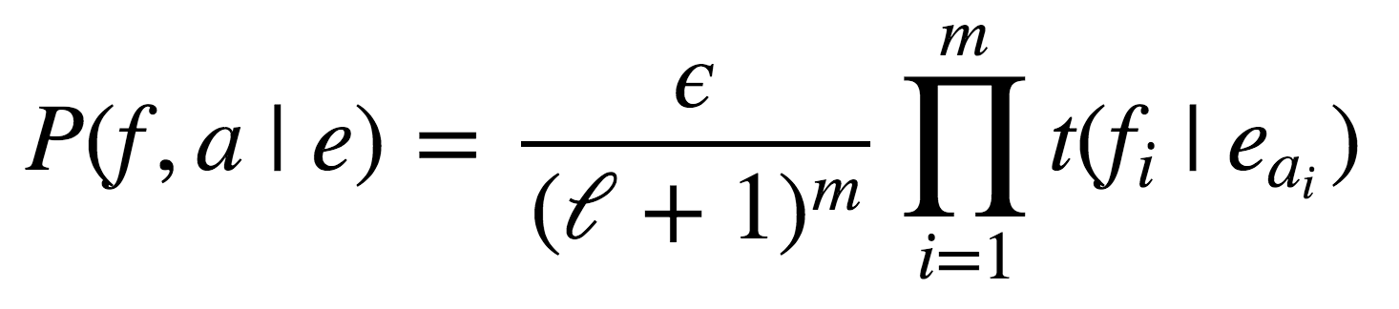
IBM Model 1
the
blue
house
NULL
Noisy-channel translation f → e
Model: generative process e → f with P(f | e)
Sample a length m ∼ Q(m)
Distribution Q(m) doesn’t matter!
Sample an alignment {a_{i}} for i = 1,...,m
a_{i} ∼ Uniform(0, ℓ + 1)
a_{i} independent
Sample a word f_{i} from t(f | e_{ai})
t(f | e) tabulated
la
maison
bleue

Slide 42
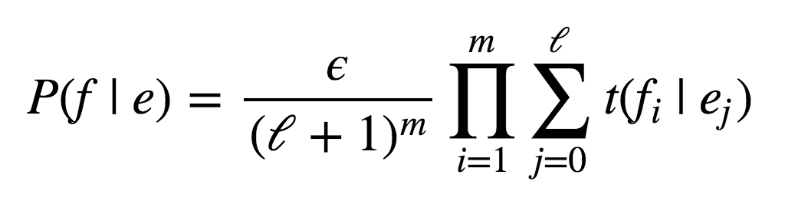
IBM Model 1
the
blue
house
NULL
Noisy-channel translation f → e
Model: generative process e → f with P(f | e)
Sample a length m ∼ Q(m)
Distribution Q(m) doesn’t matter!
Marginalize alignment {a_{i}} for i = 1,...,m
a_{i} ∼ Uniform(0, ℓ + 1)
a_{i} independent
Sample a word f_{i} from t(f | e_{ai})
t(f | e) tabulated
la
maison
bleue

Slide 43
IBM Model 1: Inference
?
?
?
NULL
Noisy-channel translation f → e
Model: generative process e → f with P(f | e)
Closed-form expression for P(f | e)
As long as t(f | e) known
Alignments are implicit (summed out)
Use Bayes’ rule to compute P(e | f)
Decode using beam search over P(f | e) P(e)
la
maison
bleue

Slide 44
Training Model 1

Slide 45
IBM Alignment Models: Training
Generative process e → f with P(f | e)
Latent variable model for P(f | e)
P(f | e) = P(f | a, e) P(a | e)
Hidden variable: alignment a_{i}
Parameters: t(f | e_{ai})
Observe (f, e). Need to infer parameters!
But, a_{i} unobserved: use EM
E-step: infer p(a_{i} | f, e)
M-step: estimate t(f | e_{ai})
P(e)
e
p(a | e)
P(a | e)
P(a | f, e)
t(f | e)
P(f | a, e)
f
Generation
(never used)
Training

Slide 46
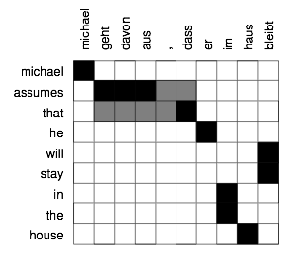
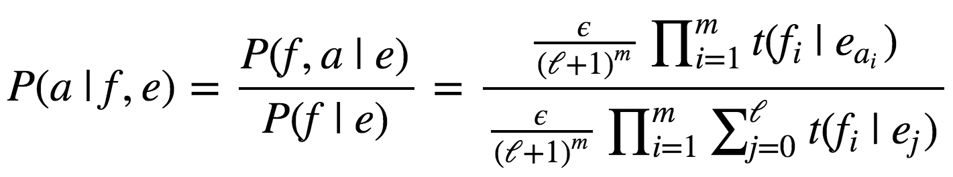
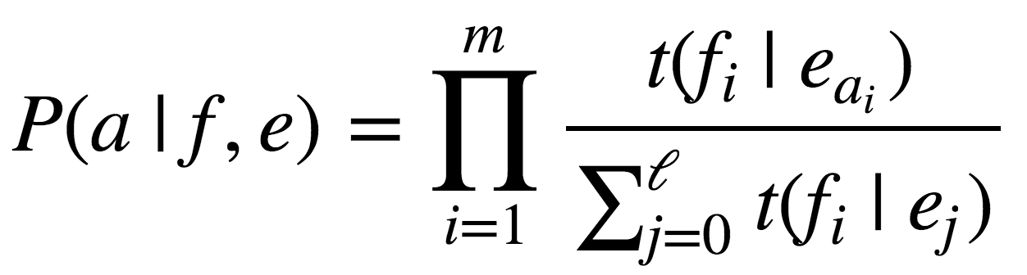
IBM Model 1: Training
Observe (f, e). Need to infer parameters!
But, a_{i} unobserved: use EM
E-step: infer p(a_{i} | f, e)
M-step: estimate t(f | e_{ai})
e
p(a | e)
P(a | f, e)
t(f | e)
f
Training

Slide 47
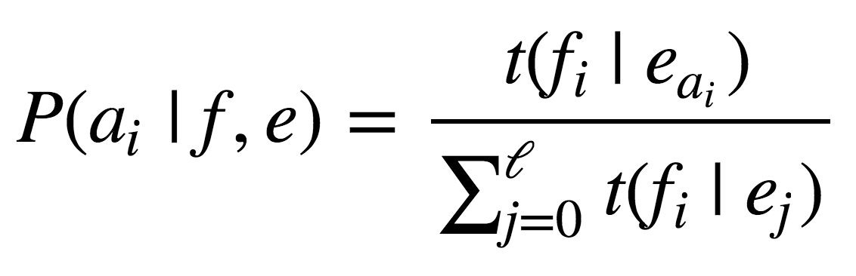
IBM Model 1: Training
Observe (f, e). Need to infer parameters!
But, a_{i} unobserved: use EM
E-step: infer p(a_{i} | f, e)
M-step: estimate t(f | e_{ai})
e
p(a | e)
P(a | f, e)
t(f | e)
f
Training

Slide 48
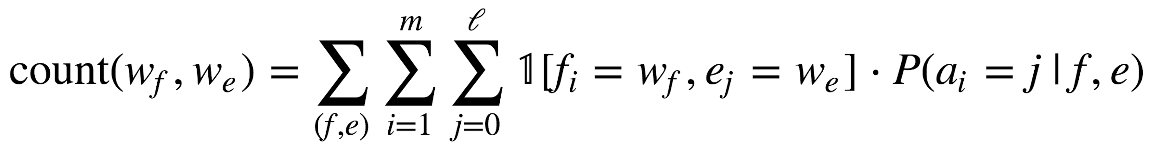
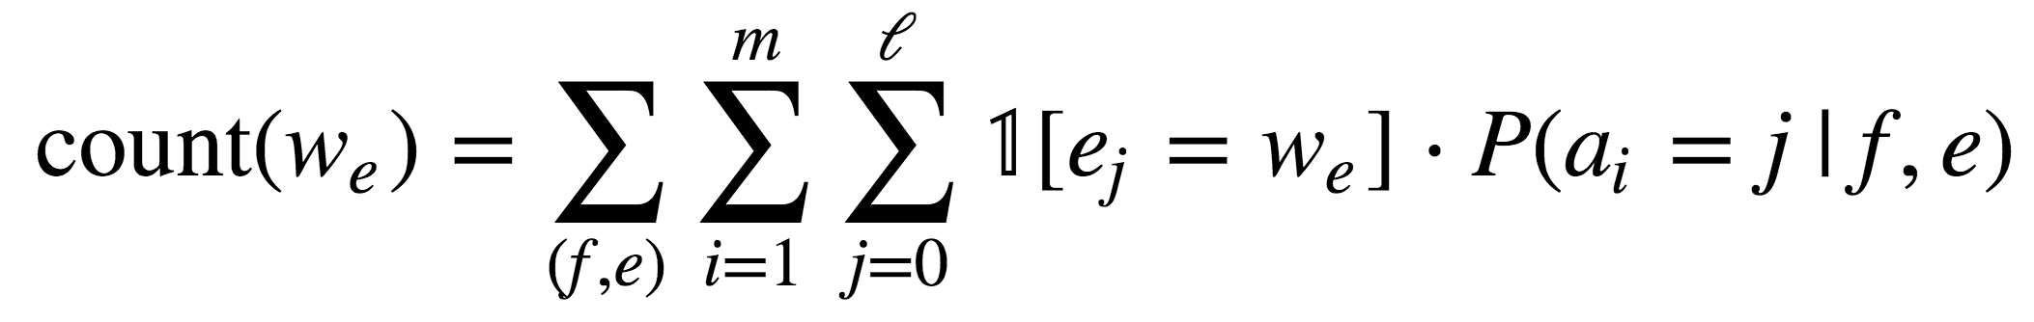
IBM Model 1: Training
Observe (f, e). Need to infer parameters!
But, a_{i} unobserved: use EM
E-step: infer p(a_{i} | f, e)
M-step: estimate t(f | e_{ai})
t(w_{f} | w_{e}) = count(w_{f}, w_{e}) / count(w_{e})
e
p(a | e)
P(a | f, e)
t(f | e)
f
Training

Slide 49
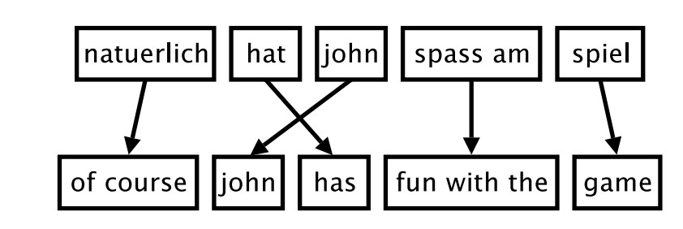
Phrase-Based MT
Problem: words are not independent!
Common patterns: [eat apples] ↔ [manger des pommes]
Idiomatic or non-compositional: [kick the bucket] ↔ [casser sa pipe]
Idea: translate in larger chunks - phrase units
Pre-segment input(s)
Translate each segment
(inference) beam decode

Slide 50
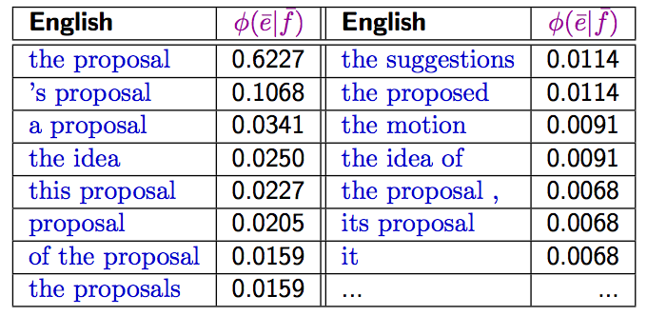
Phrase-Based MT
Generate phrases by heuristics or ML
Variable length
No linguistic constraints
Koehn (2009) Statistical Machine Translation

Slide 51
A Taste of Neural MT

Slide 52
Neural seq2seq Models
Google’s GNMT system: https://translate.google.com/
End-to-End Sequence-to-Sequence models:
Input: source language sentence
Output: target language sentence
the
blue
house
</s>
la
maison
bleue
</s>
<s>
the
blue
house

Slide 53
End of Week 1

Slide 54
Week 2: beam search, seq2seq & attention

Slide 55
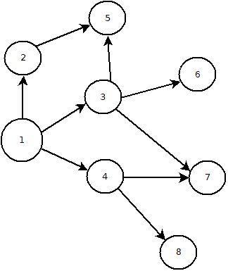
Efficient searching in infinite space
Graph expansion
Breadth first search

Slide 56
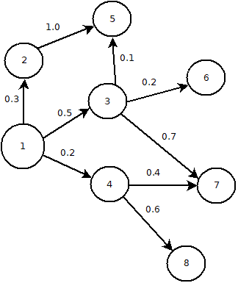
Efficient searching in infinite space
Graph expansion
Breadth first search
Best first search
Heuristics
Greedy algorithms

Slide 57
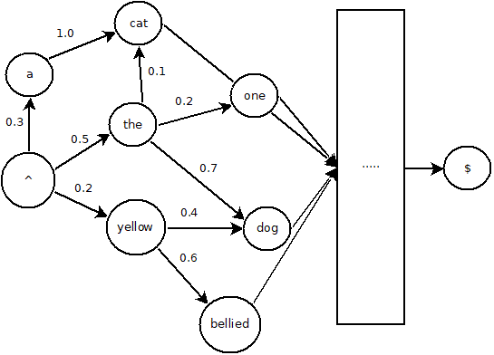
Efficient searching in infinite space
Graph expansion
Breadth first search
Best first search
Heuristics
Greedy algorithms
Applicability to MT
Graph of all possible sentences
Sentence probability as heuristic
Path dependence

Slide 58
Beam Search
Best first search potentially requires infinite memory
Bound memory by bounding size of the horizon
Beam size = number of unexpanded nodes
Expand best node → stack rank → apply beam size
Non-optimal solution
Softmax layer provides heuristic

Slide 60
Neural seq2seq Models
Google’s GNMT system: https://translate.google.com/
End-to-End Sequence-to-Sequence models:
Input: source language sentence
Output: target language sentence
the
blue
house
</s>
la
maison
bleue
</s>
<s>
the
blue
house

Slide 61
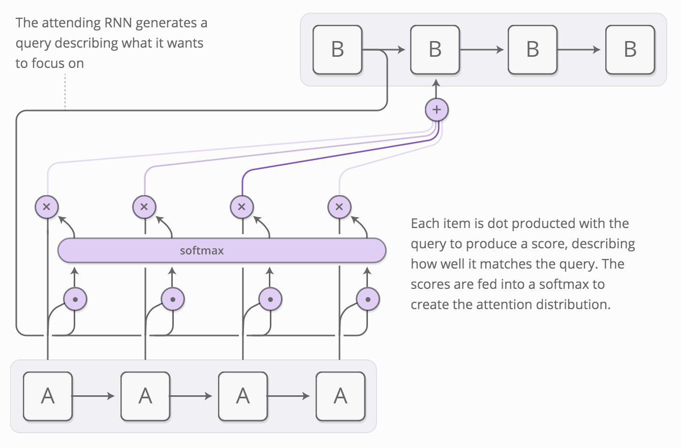
Attention Models
Problem: fixed-length vector representation
Bad for long sentences!
Idea: allow model to look back at input sequence during decoding
Acts as a sort of “memory”
Cognitively plausible?
Bonus: get alignments! (or something like them)
Image by Chris Olah and Shan Carter

Slide 62
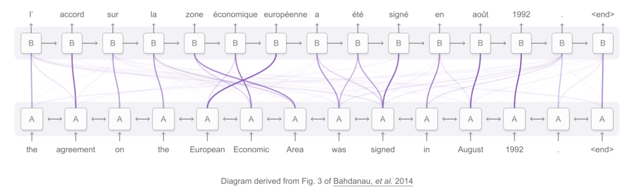
Attention Models: Example

Slide 63
Attention Demo
-> go here

Slide 64
More advanced models

Slide 65
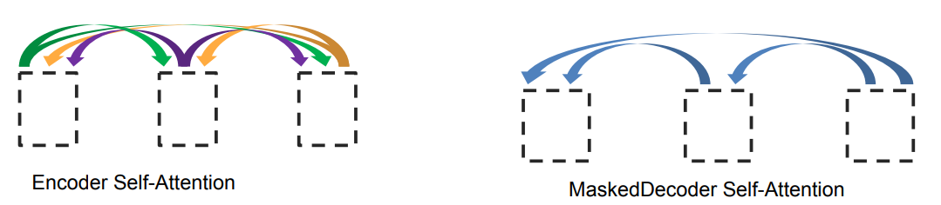
Attention is All You Need? (Vaswani et al. 2017)
What if we replaced the entire RNN with self-attention?
Repeated self-attention layers for encoder
Decoder uses masked self-attention for sequential output
Sinusoidal timing signal to distinguish position
Graphic from Lukasz Kaiser: https://nlp.stanford.edu/seminar/details/lkaiser.pdf
Notes:
See https://research.googleblog.com/2017/08/transformer-novel-neural-network.html and Vaswani et al. 2017

Slide 66

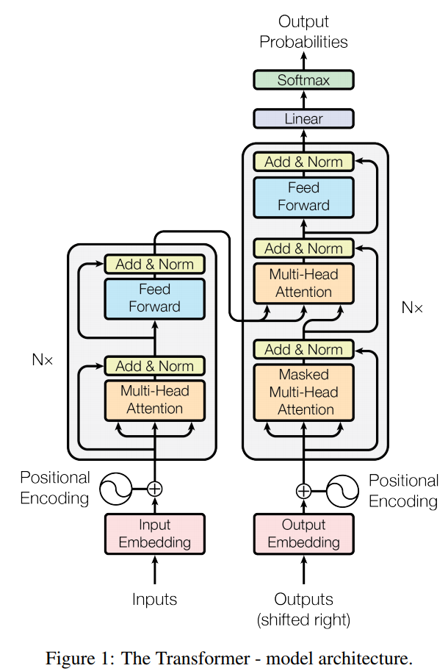
Attention is All You Need
From Vaswani et al. 2017 and https://research.googleblog.com/2017/08/transformer-novel-neural-network.html

Slide 67
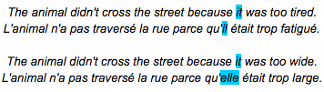
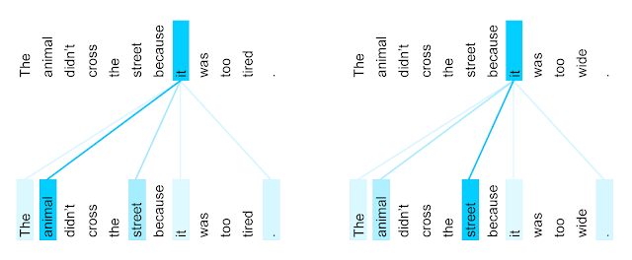
Attention is All You Need
Winograd schema: coreference examples
Look at en -> fr where coref needed for correct translation
Attention head learns to pick the correct antecedent!

Slide 68
Multilingual NMT (Johnson et al. 2016)
Train a single model on many language pairs (many to many)
Train with special target token:
Comí la comida. <2en> I ate the food.
W266 is my favorite class ! <2fr> W266 est ma classe préférée.
Shared vocabulary using word-pieces (Schuster and Nakajima 2012):
Words: Jet makers feud over seat width with big orders at stake
Wordpieces: _J et _makers _fe ud _over _seat _width _with _big _orders _at _stake
Notes:
Also related, some prior work by our very own Dan Gillick, with a similar style of multilingual model for NER: https://arxiv.org/pdf/1512.00103.pdf

Slide 69
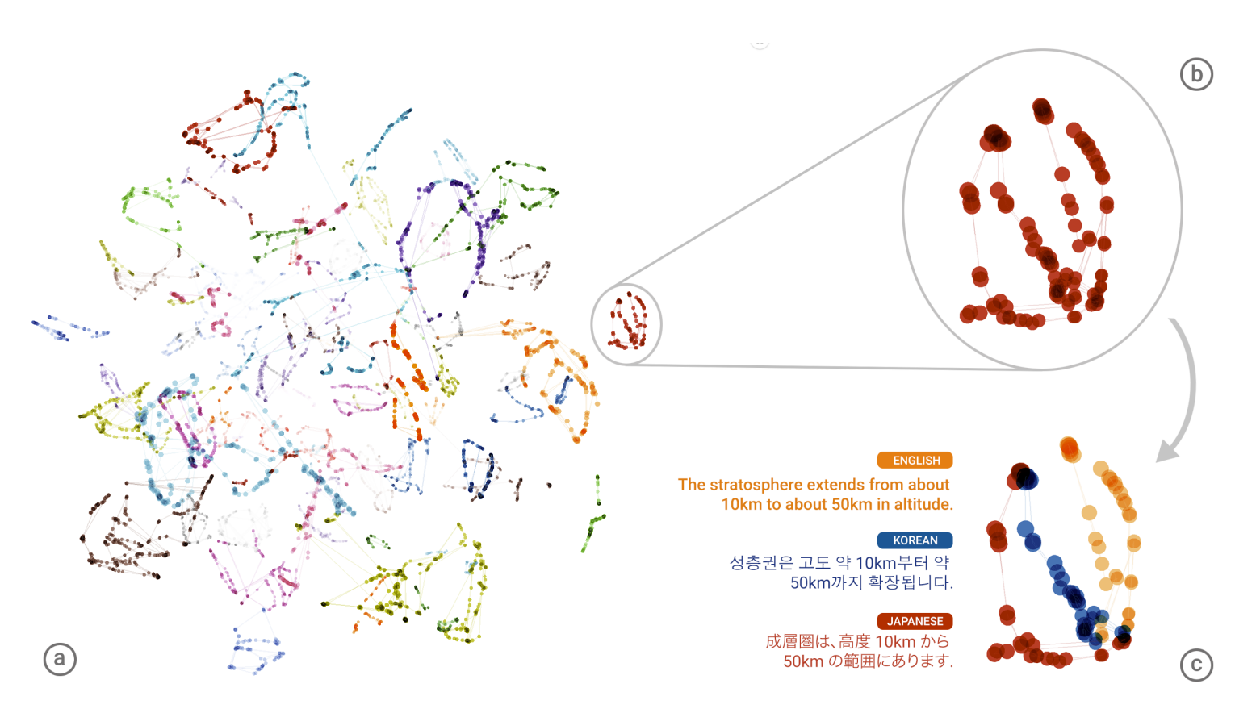
Multilingual NMT: Evidence of Interlingua
Single model:
en -> ja
ja -> en
en -> ko
ko -> en
Figure 2 of Johnson et al. 2016

Slide 70
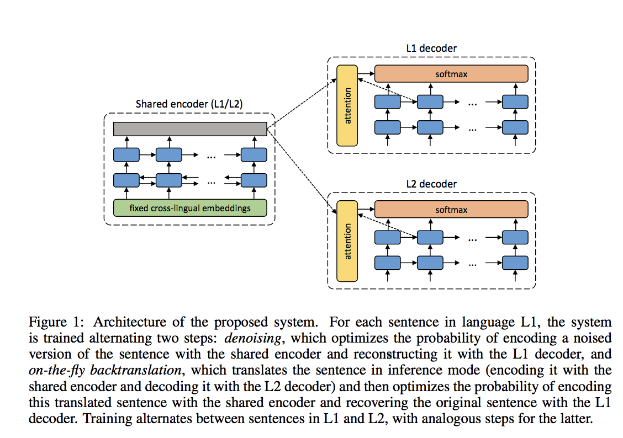
Monolingual Training
Unsupervised Neural Machine Translation (Artetxe et al. 2018)

Slide 71
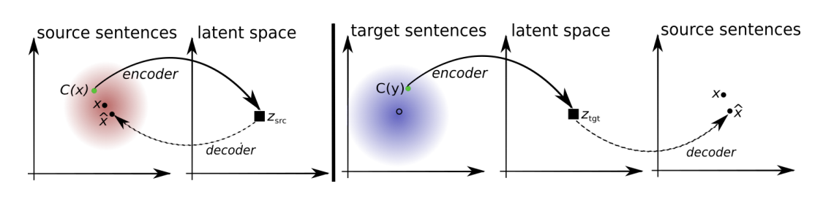
Monolingual Training
Unsupervised Machine Translation using Monolingual Corpora Only (Lample et al. 2018)

Slide 72
Convolutional Neural Networks

Slide 73

https://developer.apple.com/library/content/documentation/Performance/Conceptual/vImage/ConvolutionOperations/ConvolutionOperations.html

Slide 74
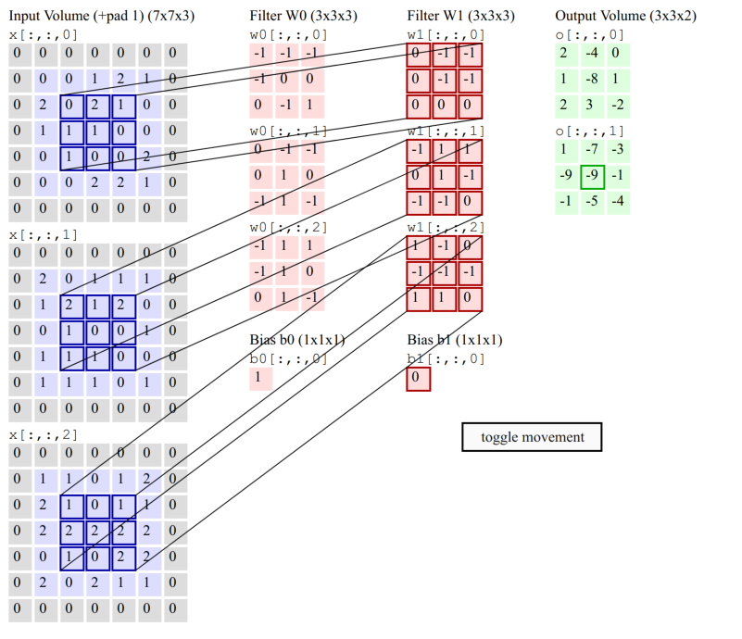

Slide 75
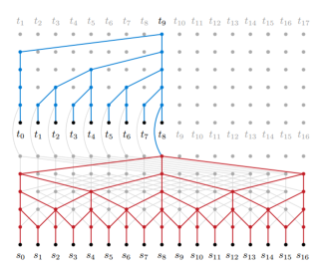
ByteNet: Convolution over characters
Neural Machine Translation in Linear* Time, Kalchbrenner et al, March 2017
Notes:
(It’s not really linear - you need depth proportional to log(n) )

Slide 76
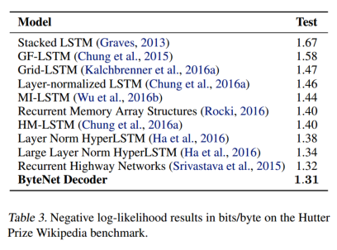
ByteNet: Language Model

Slide 77
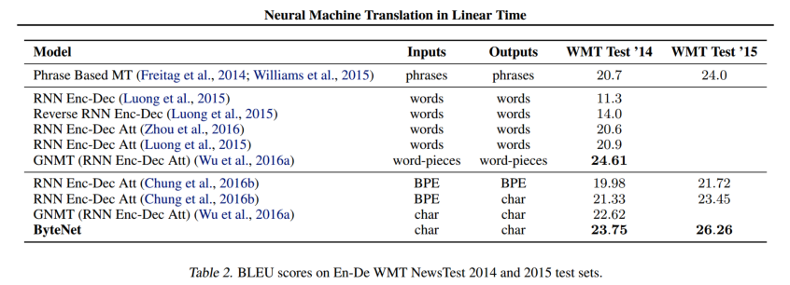
ByteNet: Translation Model

Slide 78
Appendix

Slide 79
Word Alignments: Cross-Lingual Parsing

Slide 80
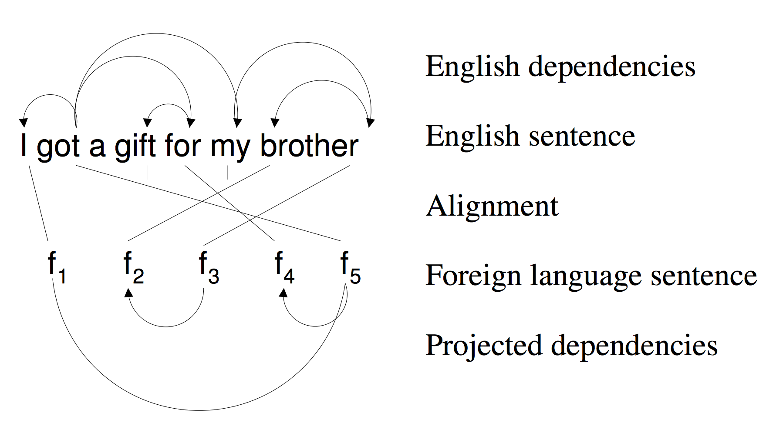
Cross-Lingual Parsing
Neural MT doesn’t need explicit alignment model.
But: alignments useful for domain transfer!
Input: English parser
Input: parallel sentences (f, e)
Output: parsed foreign sentences
Source: “Bootstrapping Parsers via Syntactic Projection across Parallel Texts” (Hwa et al. 2005)

Slide 81
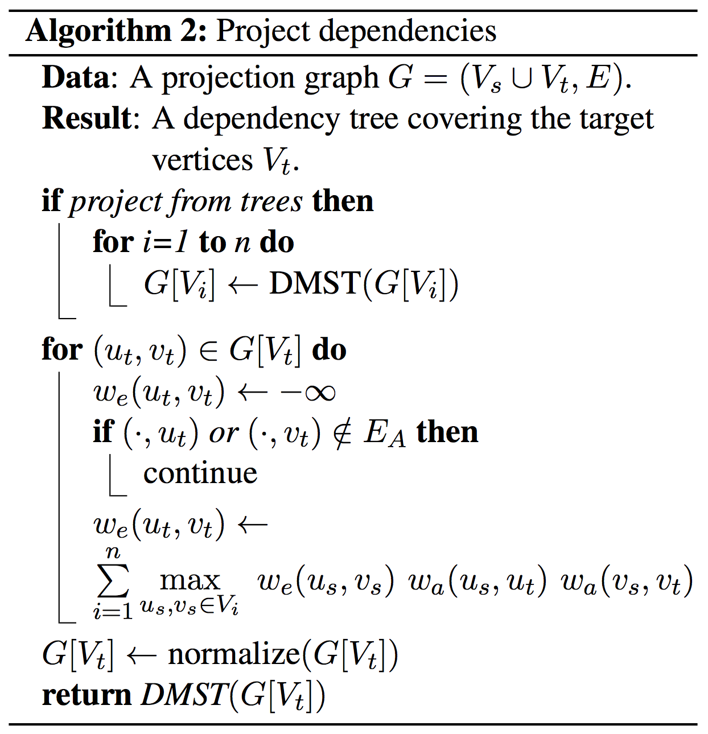
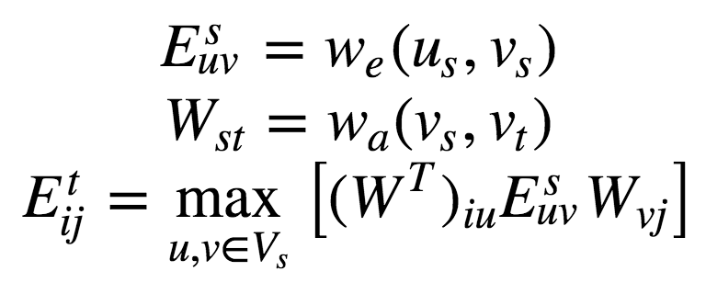
Cross-Lingual Parsing
(almost) Equivalent to matrix multiplication:
If interested in typed edges, can treat E as 3rd-rank tensor
Normalize columns of E^{t}, then DMST to decode
Source: Multilingual Projection for Parsing Truly Low-Resource Languages (Agic, et al. 2016)

Slide 82
Better models?

Slide 83
Model 1 Limitations
Bag-of-words model! (yuck)
P(f | e) doesn’t depend on order of sequence e
Thus, P(e | f) relies on LM P(e) for fluency
Problems?
Alignments all independent
No many-to-one alignments, or many-to-many
Problems?
Word-factored - problems?

Slide 84
Model 1 vs. Model 2
Model 1: “bag of words”
Generative process e → f with P(f | e)
Sample a length m ∼ Q(m)
Distribution Q(m) doesn’t matter!
Sample an alignment {a_{i}} for i = 1,...,m
a_{i} ∼ Uniform(0, ℓ + 1)
a_{i} independent
Sample a word f_{i} from t(f | e_{ai})
t(f | e) tabulated
Model 2: distortion probabilities
Generative process e → f with P(f | e)
Sample a length m ∼ Q(m)
Distribution Q(m) doesn’t matter!
Sample an alignment {a_{i}} for i = 1,...,m
a_{i} ∼ a(a_{i}| i, ℓ, m)
a_{i} independent
Sample a word f_{i} from t(f | e_{ai})
t(f | e) tabulated
Notes:
Note: often train Model 1 and use the translation probabilities t(f | e) to initialize a more sophisticated alignment model.
Distortion probability: raise a small constant to the distance between phrases.

Slide 85
HMM Model
HMM: sequence model over alignments
Generative process e → f with P(f | e)
Sample a length m ∼ Q(m)
Distribution Q(m) doesn’t matter!
Sample an alignment {a_{i}} for i = 1,...,m
a_{i} ∼ a(a_{i}| a_{i-1})
a_{i} form Markov chain
Sample a word f_{i} from t(f | e_{ai})
t(f | e) tabulated
Model 2: distortion probabilities
Generative process e → f with P(f | e)
Sample a length m ∼ Q(m)
Distribution Q(m) doesn’t matter!
Sample an alignment {a_{i}} for i = 1,...,m
a_{i} ∼ a(a_{i}| i, ℓ, m)
a_{i} independent
Sample a word f_{i} from t(f | e_{ai})
t(f | e) tabulated

